Slide 1
10/08/21

Slide 2
Experiment goal:
To compare the effect of cleaning out dsRNA with cellulose on a OSKMNL reprogramming.
2 samples for TRA-160 & CD13 staining- in order to try to recognize the intermediate stage of transient reprogramming.
Experimental variables:
OSKMNL Cellulose/no Cellulose (duplicates- 4 wells)
OSKMNL+EKB Cellulose/no Cellulose (duplicates- 4 wells)
ModOSKMNL Cellulose/no Cellulose (duplicates- 4 wells)
ModOSKMNL +ModEKB Cellulose/no Cellulose (duplicates- 4 wells)
SG
NC

Slide 3
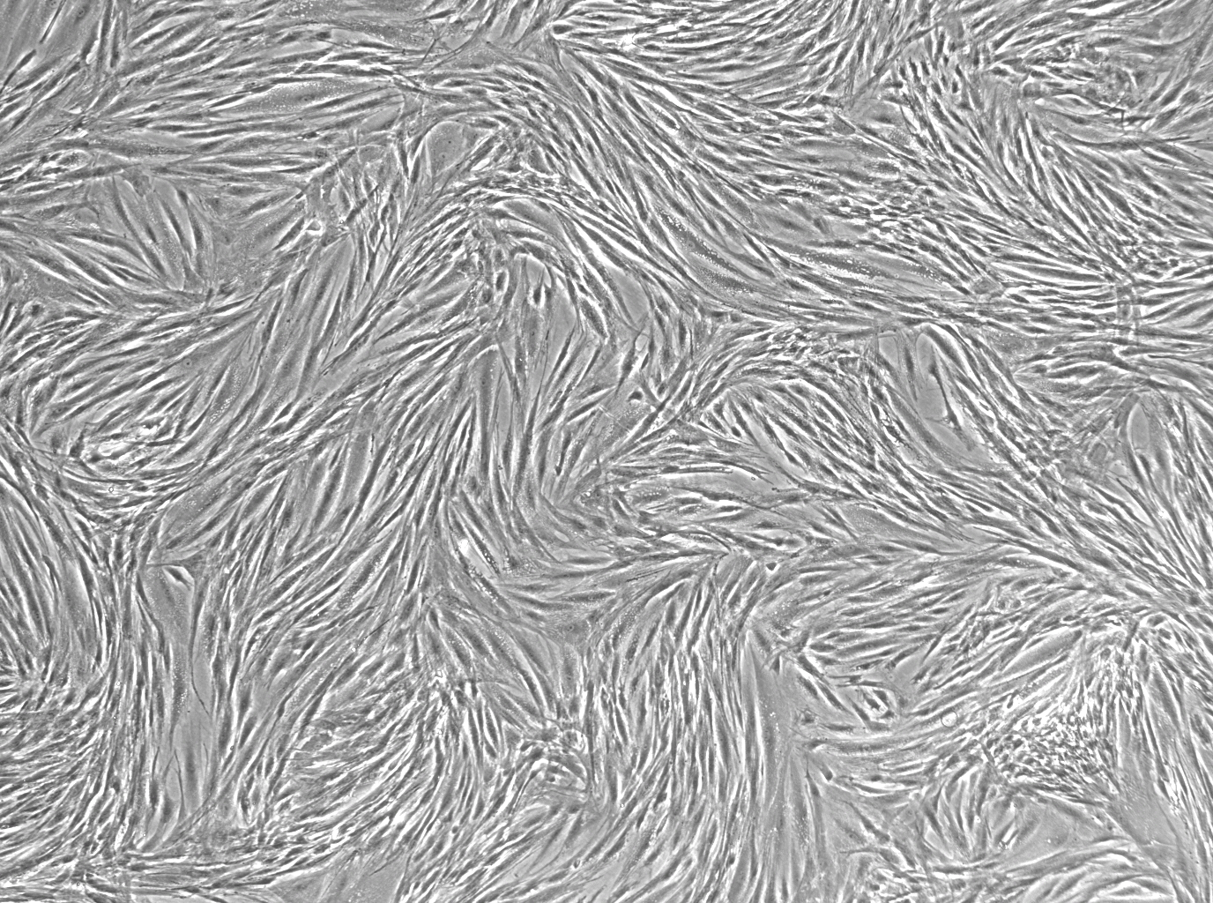
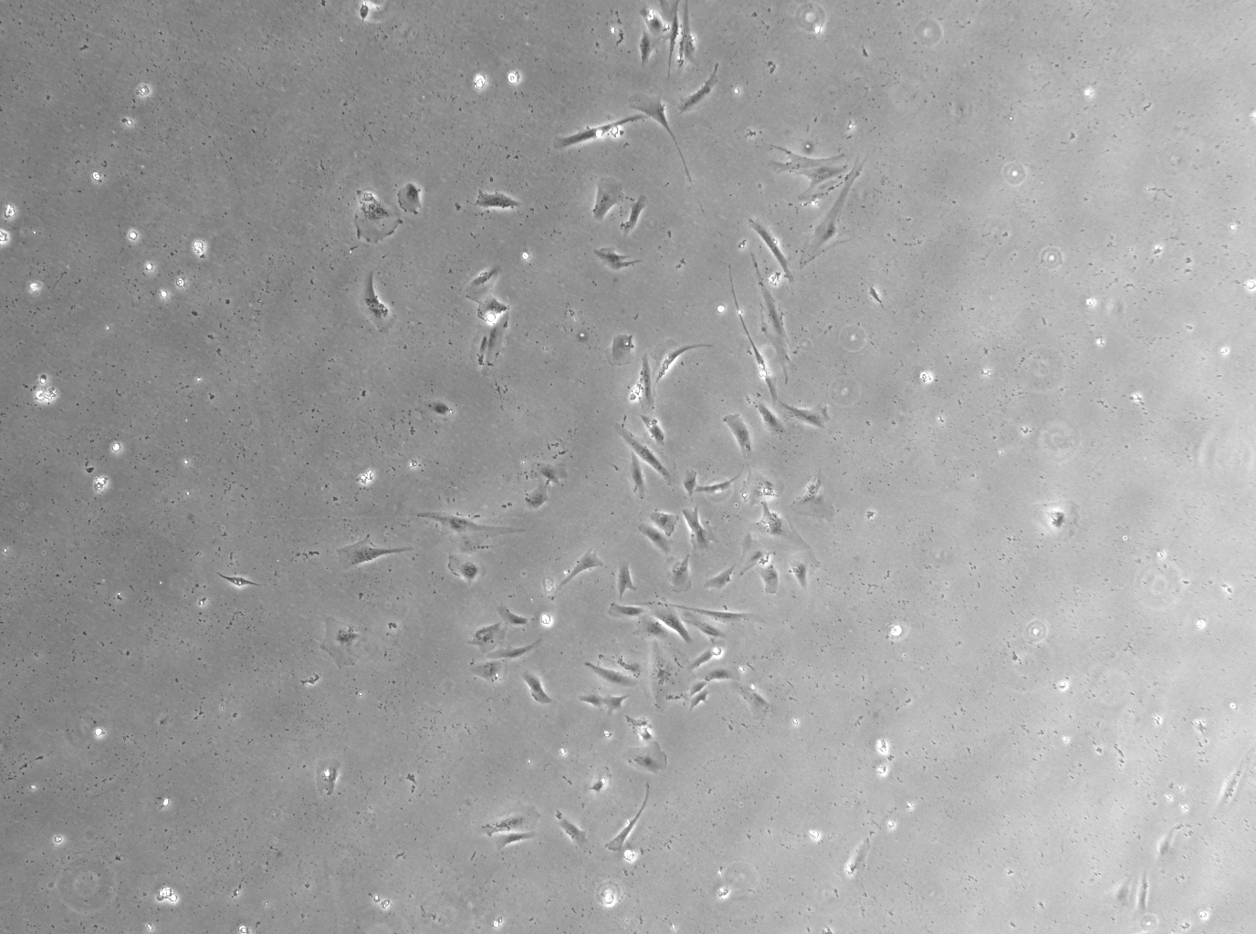
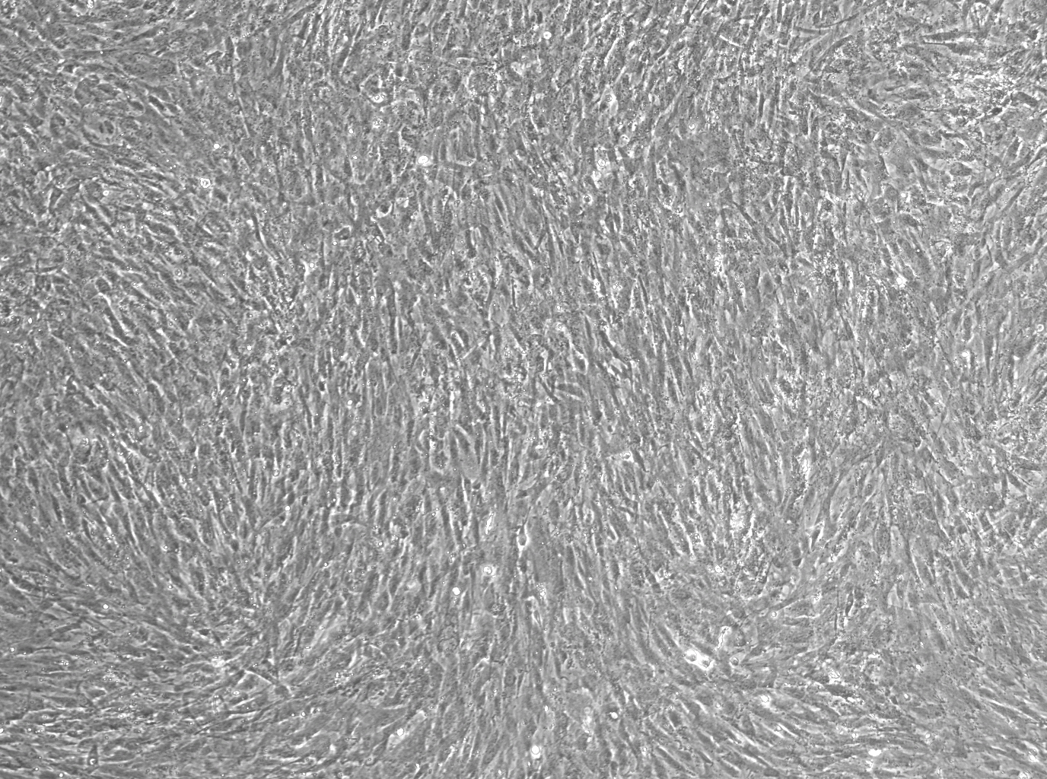
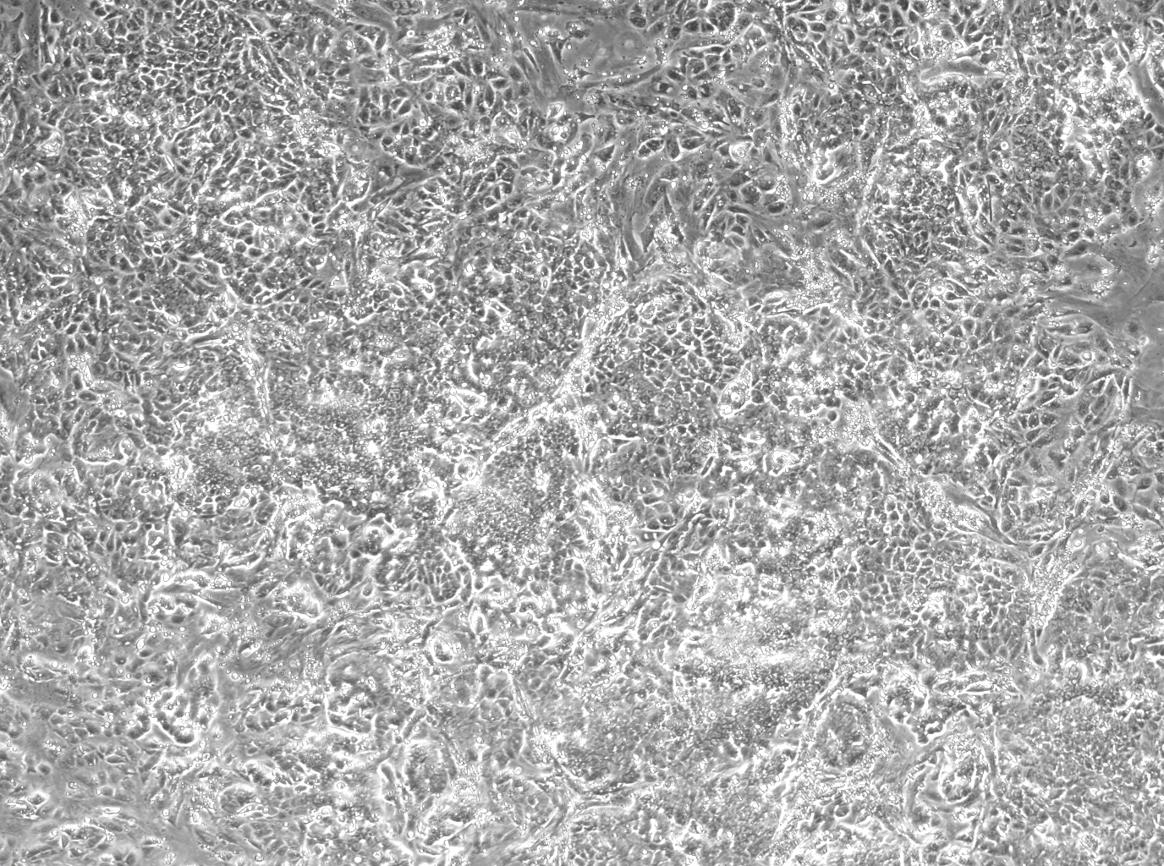
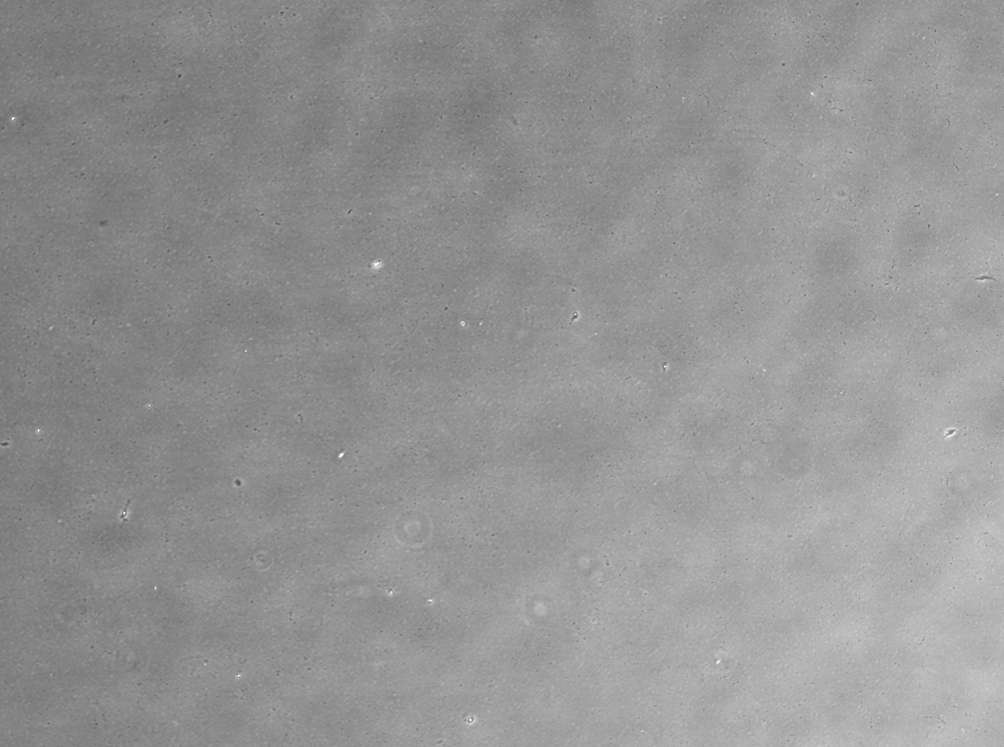
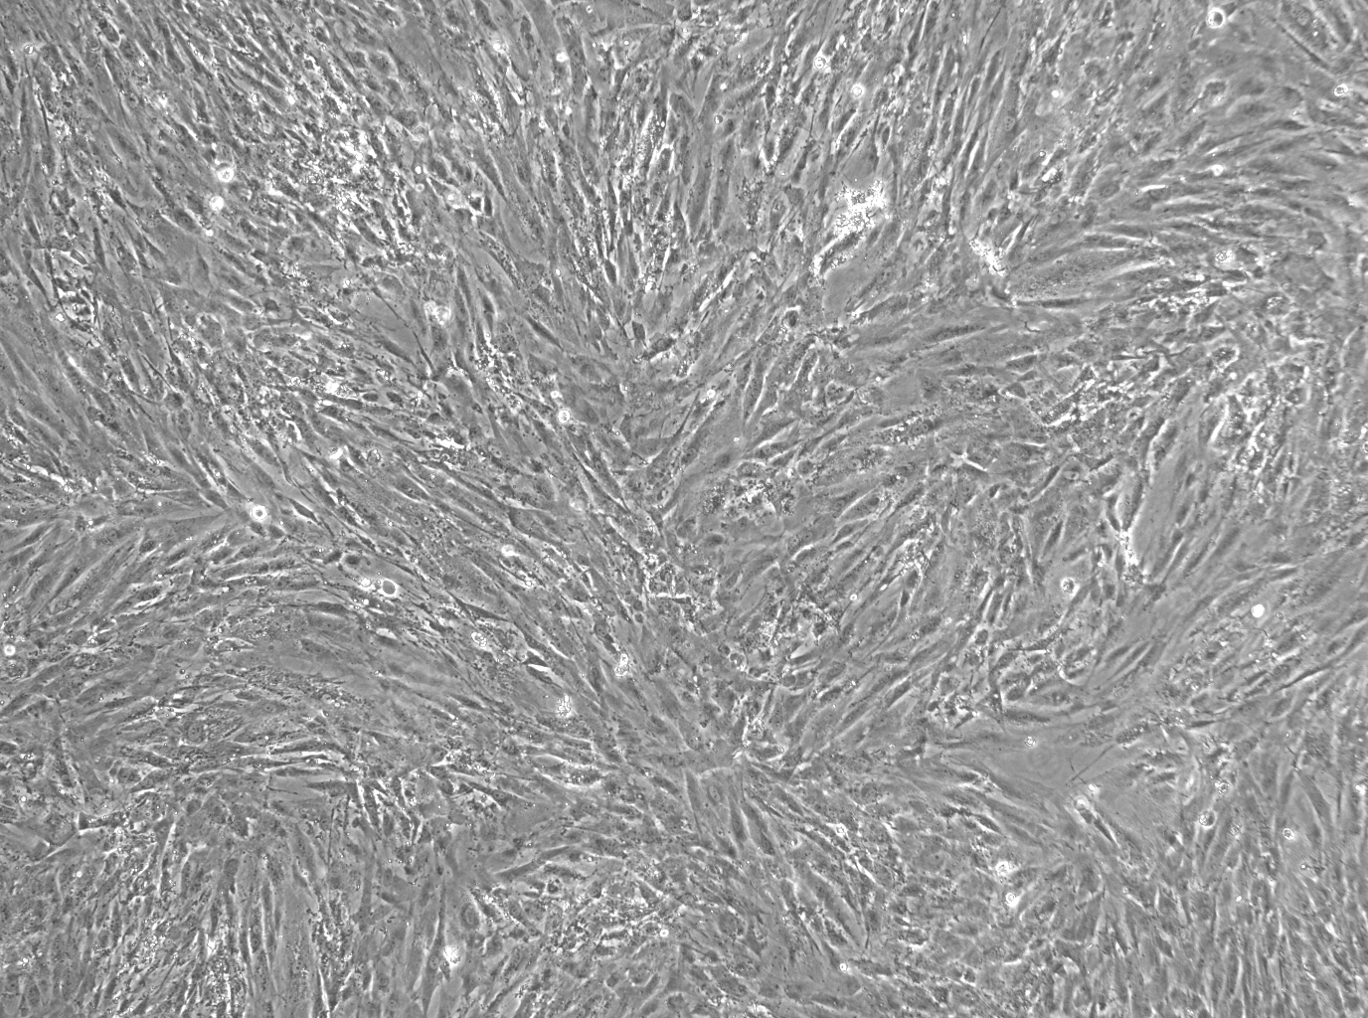
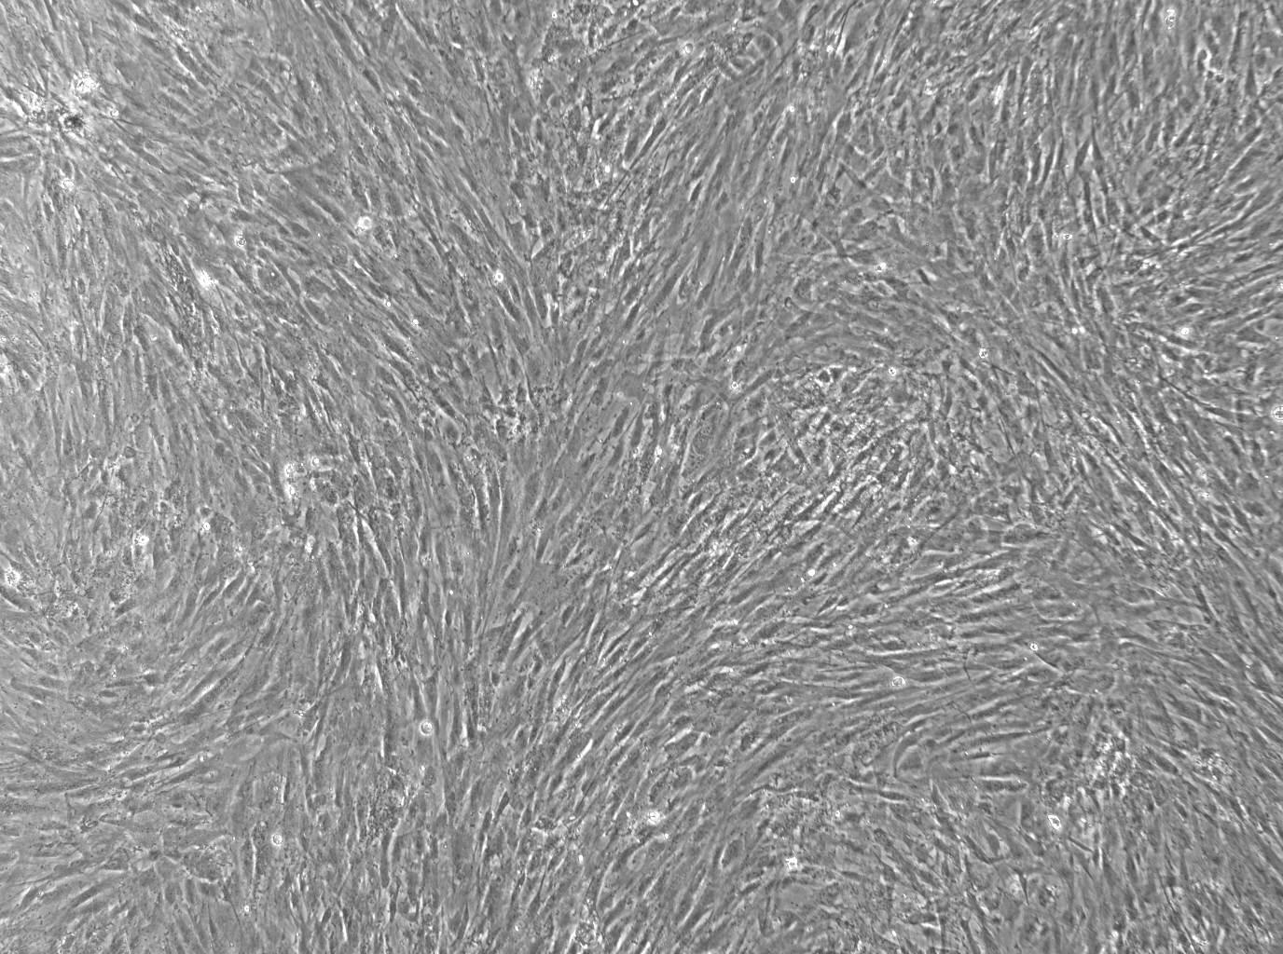
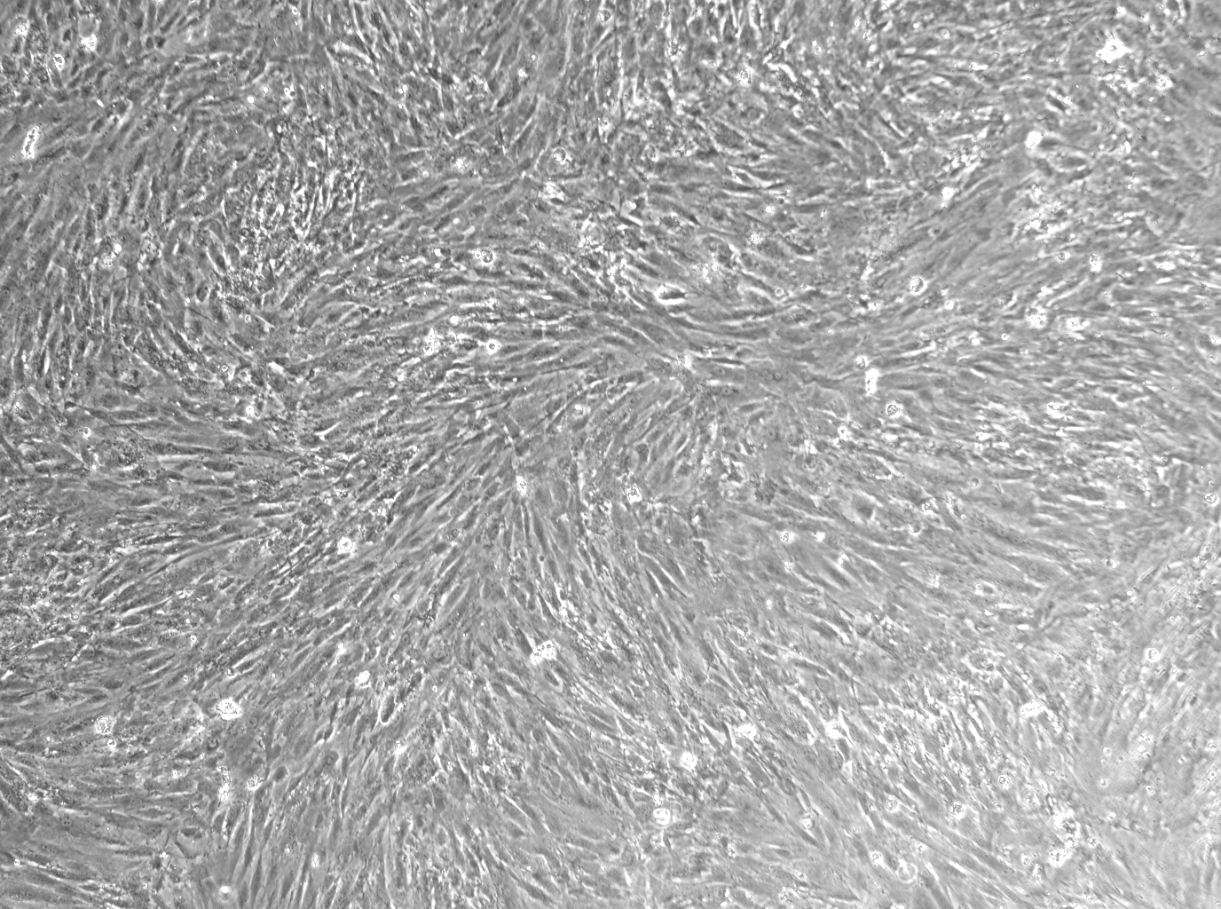
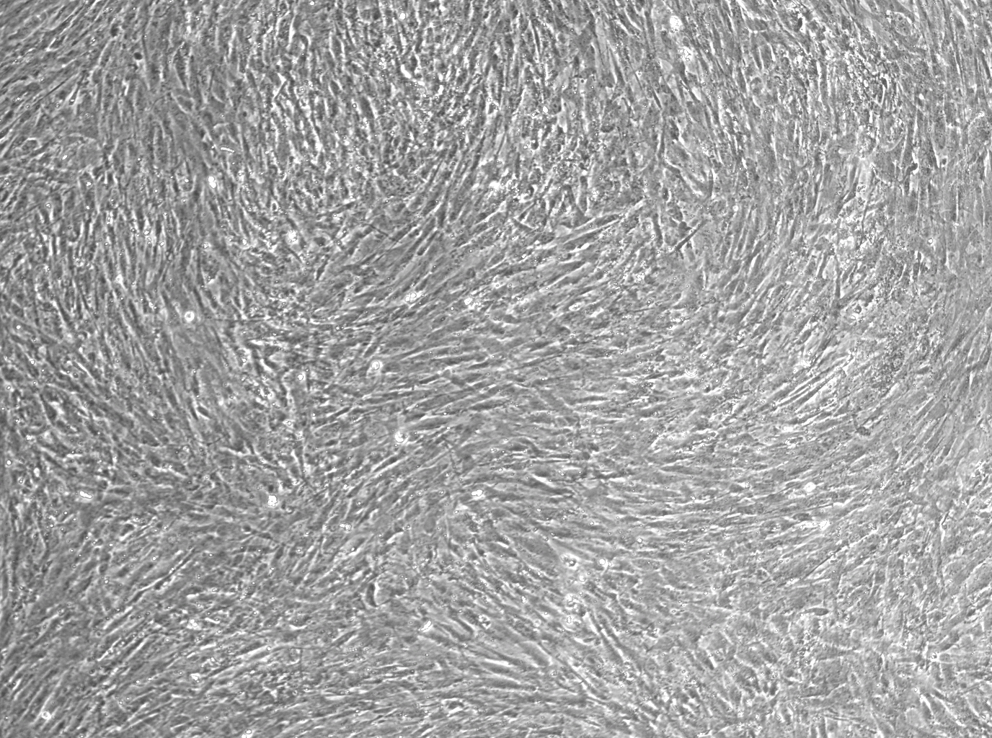
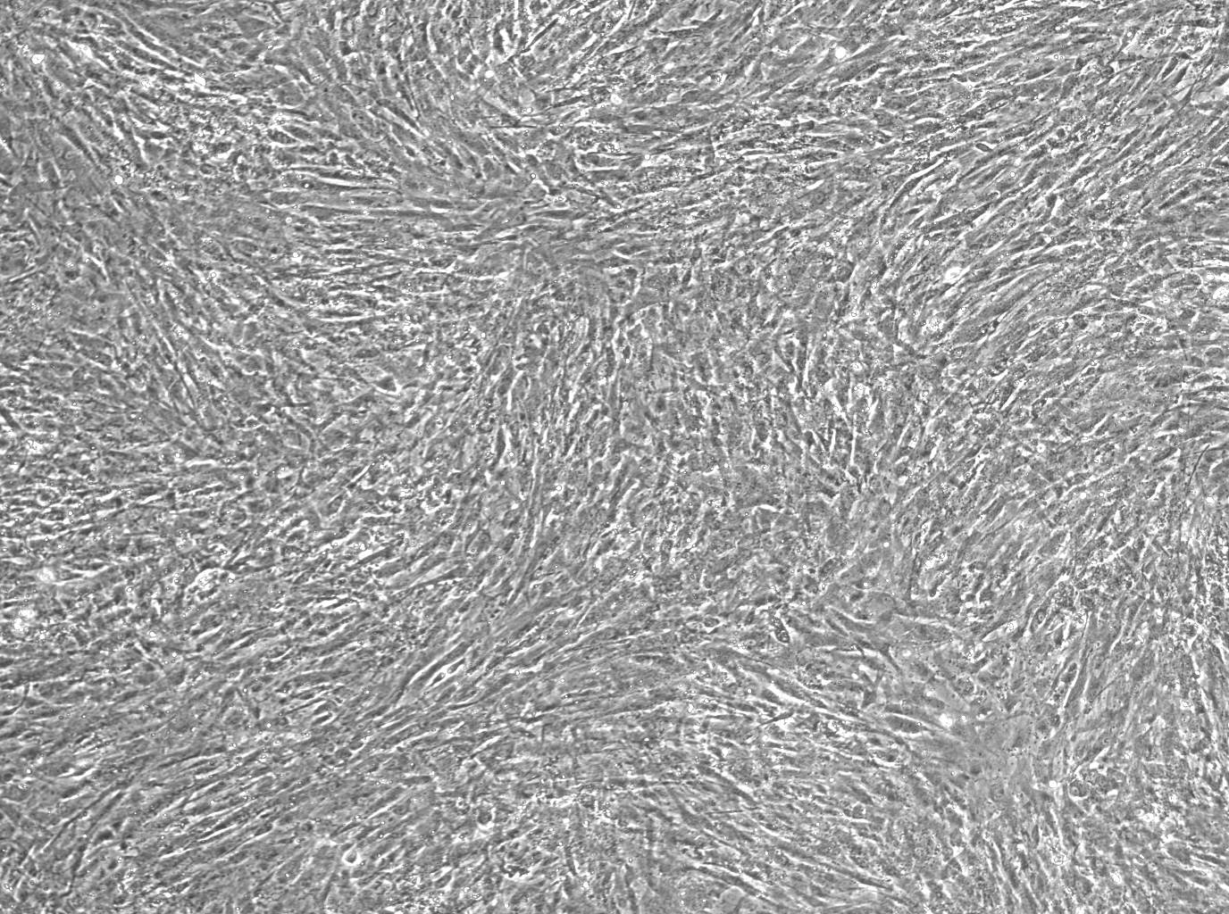
EXP’ NO.14
NC
OSKMNL+EKB
ModOSKMNL
SG
OSKMNL
OSKMNL+EKB_Cellulose
ModOSKMNL_CELLULOSE
OSKMNL_Cellulose
ModOSKMNL+ModEKB_Cellulose
ModOSKMNL+ModEKB

Slide 4
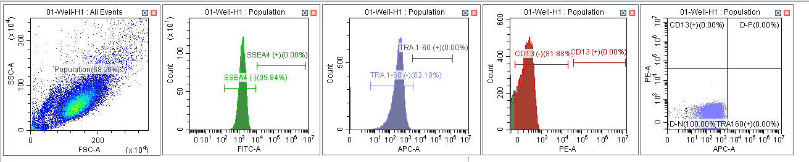
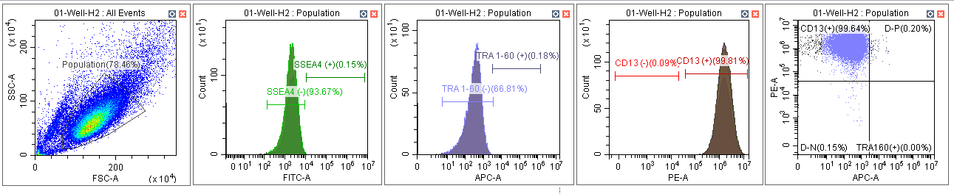
Exp’ 14
US OSKMNL+EKB/Cellulose 3 trans
DS OSKMNL+EKB/Cellulose 3 trans

Slide 5
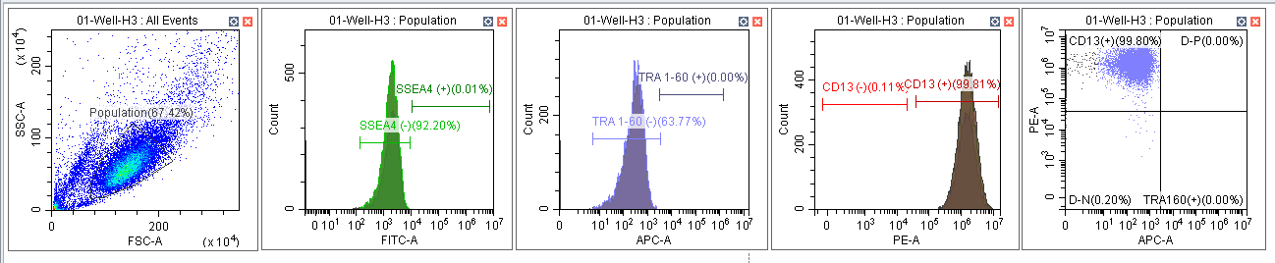
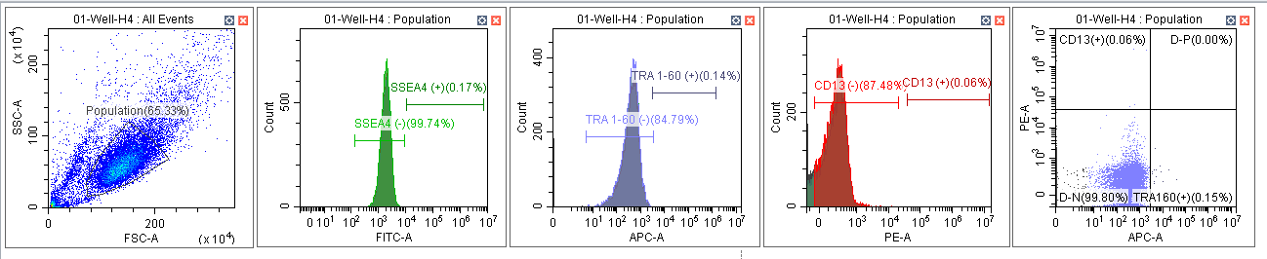
CD13 OSKMNL+EKB/Cellulose 3 trans
TRA-60 OSKMNL+EKB/Cellulose 3 trans

Slide 6
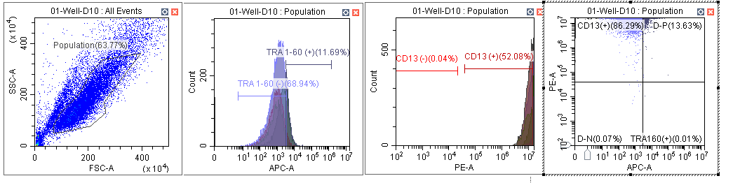
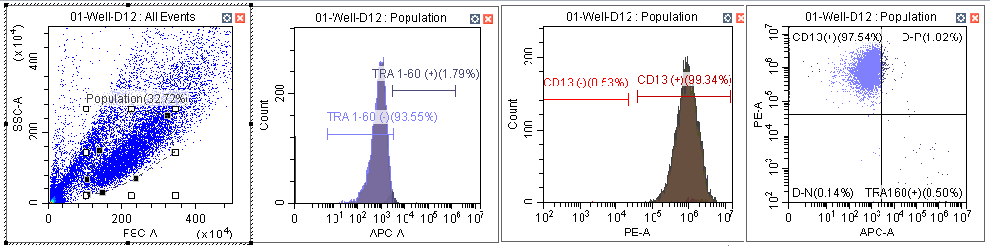
NC DS day 9
OSKMNL+EB/Cellulose DS

Slide 7
Experiment goal:
To assess the best transfection conditions for TERT expression using:
Dilutions of TERT-MYC with cellulose cleaning (MessengerMAX reagent).
TERT-GFP (+cellulose) Lipofectamine Rnaimax VS. MessengerMAX
Experimental variables:
1 transfection – duplicates wells for each sample:
TERT-MYC (1533ser) + cellulose (1200ng) X2
​TERT-MYC (1533ser) + E3 (cellulose) (1200ng TERT-MYC +200ng E3) X2
TERT-MYC (1533ser) (cellulose) + EKB SG (1200ng TERT-MYC +6ul EKB SG) X2
1:10 TERT-MYC (1533ser) + cellulose (120ng) x2
1:100 TERT-MYC (1533ser) + cellulose (12ng) x2
1:1,000 TERT-MYC (1533ser) + cellulose (1.2ng) x2
1:10,000 TERT-MYC (1533ser) + cellulose (0.12ng) x2
TERT-GFP + E3 (cellulose) Lipofectamine MessengerMAX (1200ng + 200ng E3) X2
Only Lipofectamine MessengerMAX X1
Only Lipofectamine Rnaimax X1
TERT-GFP + E3 (cellulose) Lipofectamine Rnaimax (1200ng) X2
NC (x4)

